Slide 1
STAT5003 Assignment II Credit Card Fraud Analysis
Group Project 14

Slide 2
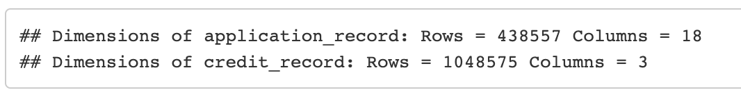
1. Data and goal
Goal: Define 'bad debtors' based on their credit history. Management of bad debt is a key value driver in banking / the credit industry.
Two datasets were provided:
application_record (18 features x 438k observations): Features: credit card application, such as ID, gender, occupation, number of children, marital status, etc.
credit_record (3 features x 1+ million observations): Customers are classified into different loan status groups (e.g. 'paid off that month', '1-29 days past due', etc.).

Slide 3
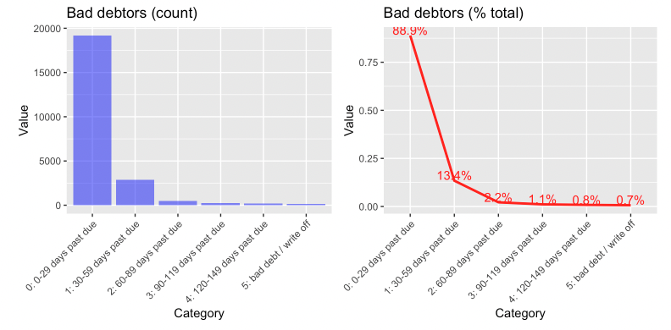
2. Credit record
Information on how credit application performs through time.
We decided to define class 1 as debt with 30+ days past due.

Slide 4
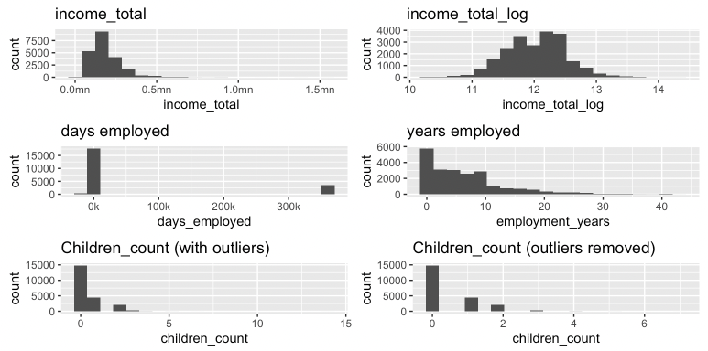
3. Application record
[.]

Slide 5
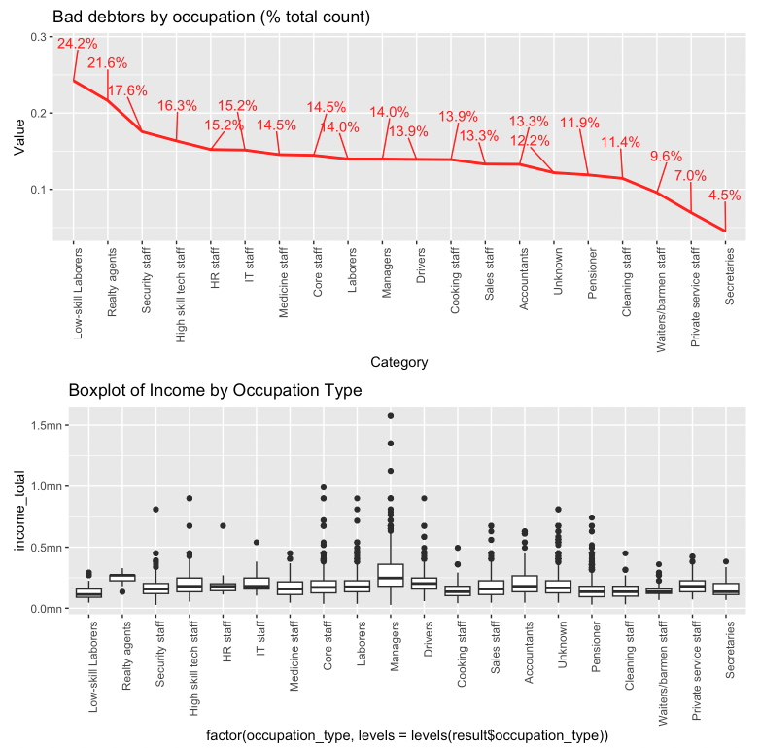
X. Data Visualization
Focusing on the highest bad debt rate:
Lower income suggests higher bad debt rate, but not in all:
Fraud?
Unstable income sources?

Slide 6
4. Challenges with dataset
Large and complex dataset: 10,000 samples, a mix of numerical and categorical values, and split data files.
Class imbalance: number of 'bad_debtors' is small compared to the overall sample size.

Slide 7
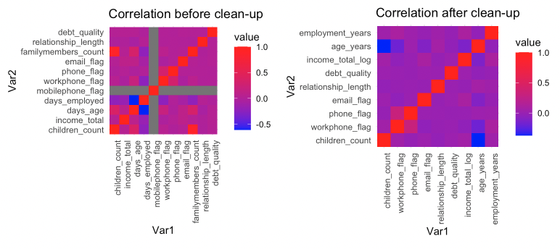
5. Data combination and cleaning (1/2)
Resulting correlation below.

Slide 8
6. Data combination and cleaning (2/2)
[.]

Slide 9
7. Pre-processing
[.]

Slide 10
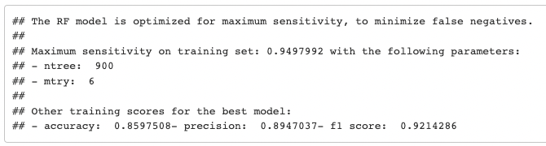
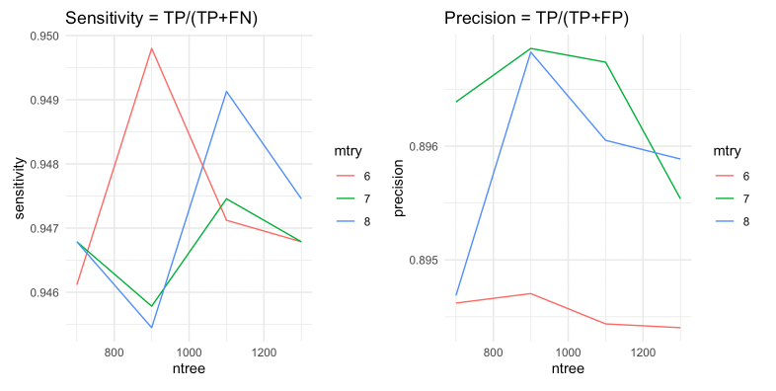
8. Model I: Random Forest (1/2)
[.]

Slide 11
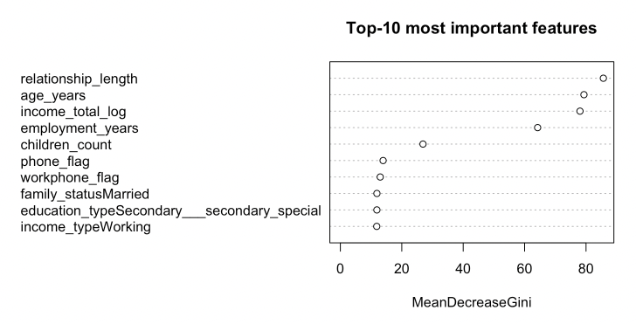
9. Model I: Random Forest (2/2)
[.]

Slide 12
10. Model II: Log Regression (1/2)
[.]

Slide 13
11. Model II: Log Regression (2/2)
[.]

Slide 14
12. Model III: Support Vector Machine (1/2)
[.]

Slide 15
13. Model III: Support Vector Machine (2/2)
[.]

Slide 16
14. Model IV: Linear Discriminant Analysis (1/2)
[.]

Slide 17
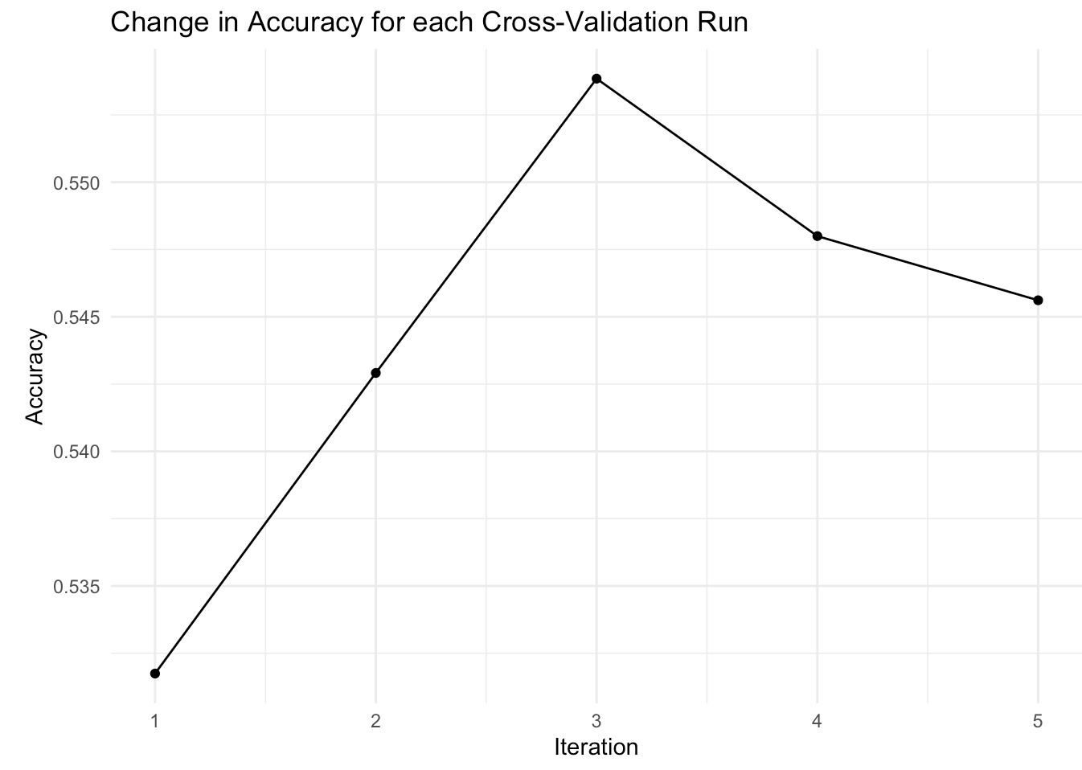
15. Model IV: Linear Discriminant Analysis (2/2)
[.]

Slide 18
16. Testing results
[.]

Slide 19
17. Proposed Model
[.]

Slide 20
18. Limitation and Recommendation for Future Work
[.]

